Slide 1
Algorithms for
Non-negative Matrix Factorization
By D. D. Lee and H. S. Seung,2001

Slide 2
Contents
NMF
Cost Functions
Multiplicative update rules
Interpretation as gradient descent
Proving the monotonic convergence

Slide 3
NMF
Nonnegative Matrix:
Non-negative matrix factorization(NMF):Using two non-negative matrices to approximate another non-negative matrix.
Significance: Relatively few basis vectors are used to represent many data vectors.

Slide 4
Cost Function
Quantify the quality of approximation.
Square of the Euclidean distance between A and B
Generalized Kullback-Leibler divergence of A from B

Slide 5
Optimization Problems
Problem 1:
Problem 2:

Slide 6
How to tackle the problems above?
They are convex in W only or H only, but not convex in both variables together.
Goal: Finding local minima
Gradient decent?
Convergence can be slow
Conjugate gradient?
More complicated to complement
Sensitive to the step size

Slide 7
Multiplicative update rules
Euclidean distance
Divergence
The Euclidean distance and divergence are not increasing under the update rules.

Slide 8
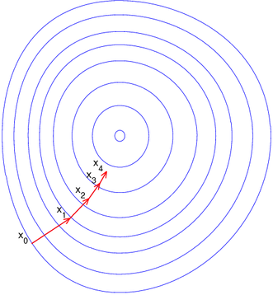
Gradient decent
Gradient decent for
The sequence converges to
the desired local minimum.

Slide 9
Multiplicative vs additive update rules
Euclidean distance
Divergence
Is it convergent, even if η is not necessarily small enough?

Slide 10
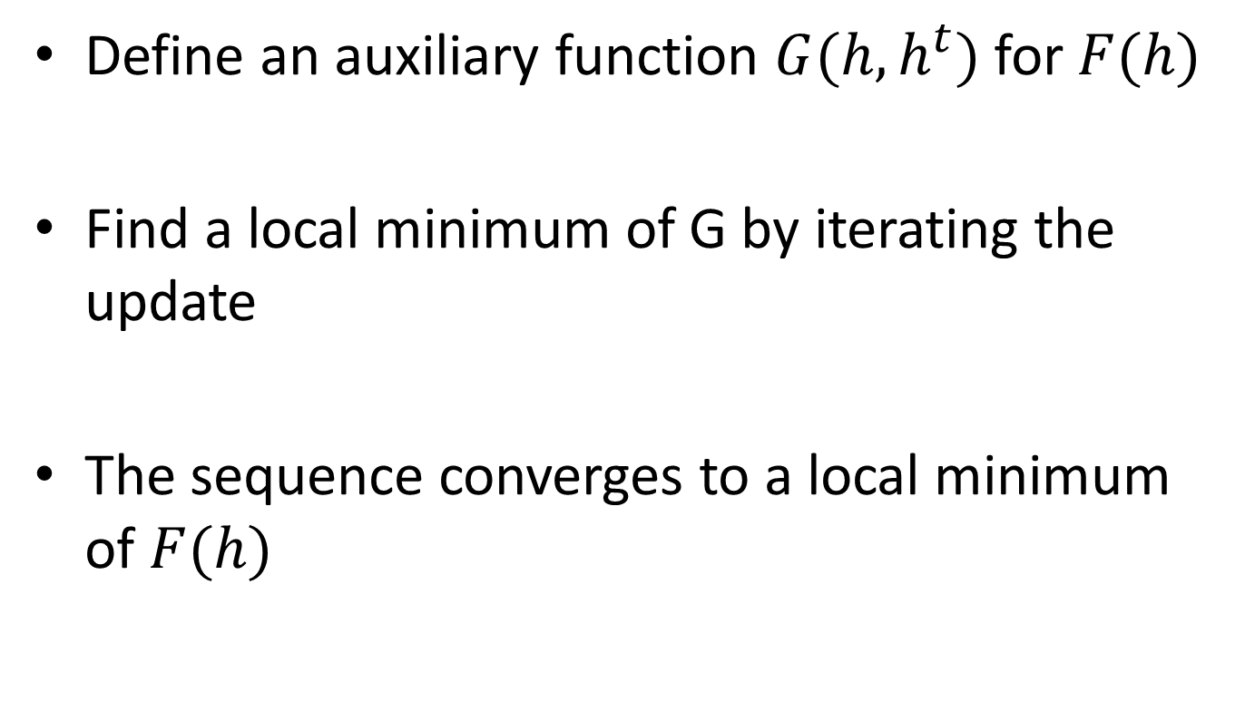
Proofs of converge
Define an auxiliary function $G(h,h^{t})$ for $F(h)$
Find a local minimum of G by iterating the update
The sequence converges to a local minimum of $F(h)$

Slide 11
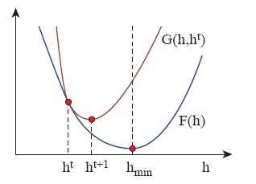
Auxiliary Function

Slide 12
Updates for H of Euclidean distance
Proving steps:
Step one
Show $G(h,h^{t})$ is an auxiliary function for $F(h)$
Show 𝐺(ℎ,ℎ^𝑡) is an auxiliary function for 𝐹(ℎ)
Step two
Obtain the update rule by setting the gradient of $G(h,h^{t})$ to zero
Obtain the update rule by setting the gradient of 𝐺(ℎ,ℎ^𝑡) to zero
Step three
Check the equivalence between the update rule and

Slide 13
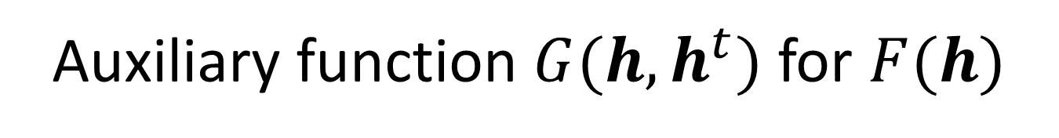
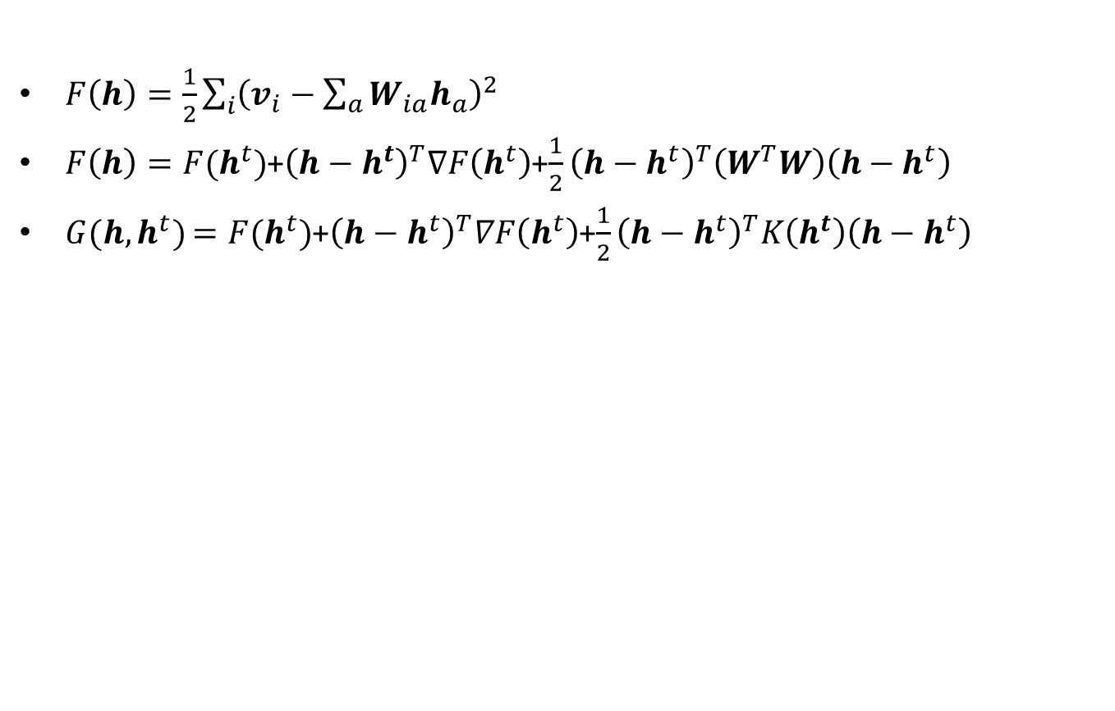
Auxiliary function $G(h,h^{t})$ for $F(h)$
$F\left(h\right)=\frac{1}{2}\sum_{i}{{\left(v_{i}−\sum_{a}{W_{ia}h_{a}}\right)}^{2}}$
$F\left(h\right)=F(h^{t})$+${\left(h−h^{t}\right)}^{T}∇F\left(h^{t}\right)$+$\frac{1}{2}{\left(h−h^{t}\right)}^{T}\left(W^{T}W\right)\left(h−h^{t}\right)$
$G(h,h^{t})$ $=F(h^{t})$+${\left(h−h^{t}\right)}^{T}∇F\left(h^{t}\right)$+$\frac{1}{2}{\left(h−h^{t}\right)}^{T}K\left(h^{t}\right)\left(h−h^{t}\right)$

Slide 14

Minimum of $G(h,h^{t})$ and update rules
By reversing the role of H and W,F can be shown to be non-increasing under the update rules of for W.

Slide 15
Updates for H of divergence
Step one
Show $G(h,h^{t})$ is an auxiliary function for $F(h)$
Show 𝐺(ℎ,ℎ^𝑡) is an auxiliary function for 𝐹(ℎ)
Step two
Obtain the update rule by setting the gradient of $G(h,h^{t})$ to zero
Obtain the update rule by setting the gradient of 𝐺(ℎ,ℎ^𝑡) to zero
Step three
Check the equivalence between the update rule and

Slide 16

Proof of $G(h,h^{t})$ by convexity
The convexity of log function

Slide 17
Minimum of $G(h,h^{t})$ and update rules
By reversing the role of H and W, the update rule for W can similarly be shown to be non-increasing.

